Slide 1

The Social Identity Approach
Social Identity Theory Self-Categorisation Theory
SIAM meeting 4-5th June

Slide 2
Social Identity Theory
(Tajfel & Turner, 1979)

Slide 3
Personal identity (the singular)
Social identity
(the collective)
Academic
Crowd psychologist
Psychologist
​
​
We have multiple social identities (e.g. academic, in a cycling group, feminist)
​
We understand our self-concept in terms of which identity is salient (relevant) at a particular time (Turner, 1982).​
​
Ingroup member: someone who we perceive as being in our group​
Outgroup member: someone who we perceive as being in a different group

Slide 4

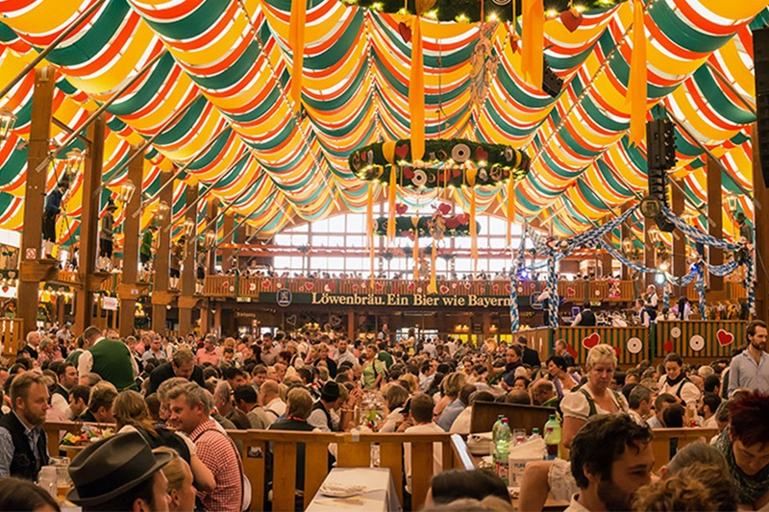
Physical crowds
Psychological crowds

Slide 5
Self-categorisation theory (Turner, 1982; Turner, Hogg, Oakes, Reicher & Wetherell, 1987)

Slide 6
Self-categorisation theory
Aims to explain how we categorise ourselves and others into groups in different contexts, and how we shift from considering ourselves as an individual to considering ourselves as a group member
Self-stereotyping: The process whereby individuals define their self in terms of their social identity and act in line with the group’s social norms.
Collective behaviour possible through the process of depersonalisation.
Depersonalisation: a shift from the personal identity to the identity as a member of a particular social group.
Here, group members perceive themselves to be part of the same group and subsequently apply the group characterises and norms to themselves when that social identity is salient.
NOTE: Does not mean we lose our personal identity, beliefs, or behave in ways we would not already do.

Slide 7
Self-categorisation theory
Comparative fit: an aggregate of people will be categorised as a group when the differences between them are less than the differences with a comparator aggregate
Meta-contrast ratio – the differences between us ingroup members are smaller than the difference between us and those outgroup members
Normative fit: Congruence between perceived social stimuli and normative expectations about different social groups
You’re acting in line with group norms – you’re one of us!

Slide 8
Transformations
Cognitive
We stop acting in terms of individual values, priorities​
We begin acting in terms of the norms, values, goals, and beliefs of our group​
Relational
Members stop being ‘other’ and become ‘like us’​
Their well-being and fate is tied to our own​
We perceive ingroup members as more favourable than outgroup members​
We have increased respect, cooperation, coordination with ingroup members​

Slide 9
Cognitive and relational transformations in practice

Slide 10
July 7th 2005 London bombings
“I felt that we’re all in the same boat together [ ] it was a stressful situation and we were all in it together and the best way to get out of it was to help each other [] I felt quite close to the people near me”
12 examples of people being observed or reporting risking their own safety to help strangers. “She stayed in the tube station that I was there, for ages, and she was first aid trained so she was kind of running around trying to do what she could”
Examples of help: ‘comforting others, offering them bottles of water, physically helping people up or along, giving people information or directions, giving first aid, tying tourniquets, and applying makeshift bandages.’
Cognitive: recategorising as ingroup based on shared fate
Relational: feeling closer
Drury, J., Cocking, C., & Reicher, S. D. (2009). The nature of collective resilience: Survivor reactions to the 2005 London bombings. International Journal of Mass Emergencies and Disasters, 27(1), 66-95. Retrieved from http://www.ijmed.org/articles/113/download/

Slide 11

Recategorising the ingroup
Study 1: study about football clubs and their fans
Method & Measures
Questionnaires primed identification with the team (e.g. how long they had supported them, how they felt about successes and failures or their team)
Identification with other supporters of the team (e.g. ‘I am a person who identifies with X fans’, ‘I am a person who is glad to be a X fan’)
As participants travelled to another location, they encountered an injured person wearing an ingroup (Man U) t-shirt, outgroup (Liverpool FC) t-shirt, or a control (plain) t-shirt. Measured how many participants offered help
Results
An injured stranger wearing an ingroup team (Manchester United) shirt is more likely to be helped than when wearing a rival team (Liverpool FC) shirt or an unbranded sports shirt.
Levine, M., Prosser, A., Evans, D., Reicher, S. (2005) Identity and Emergency Intervention: How Social Group Membership and Inclusiveness of Group Boundaries Shapes Helping Behavior

Slide 12
Recategorising the ingroup
Study 2: study about fans of football teams and that football fans have a bad reputation
Methods & Measures
Invoked a superordinate identity as a ‘football fan’. Questionnaires asked about when they first became football fans, what they liked about being a football fan, what they shared with other football fans. Same measures as in study 1
Results
Participants as likely to help injured person wearing a Liverpool FC t-shirt as a Man U t-shirt. Helping is extended to those who were previously identified as outgroup members, but not to those who do not display signs of group membership.
Cognitive: Who is classed as ingroup/outgroup
Relational: Helping ingroup members

Slide 13
Yes, yes. Very interesting Anne. But what do we do with this??

Slide 14
Next steps
Options for working together:
Designing experiments to isolate and explore behavior phenomena and psychological processes underpinning them
Test theories by simulating scenarios in controlled, safe environments
Map out core theoretical and practical considerations for simulating collective behaviour

Slide 15
Next steps
Agents should have:
Personal identity
Social identity (or multiple)
Ability to switch between identities
Personal identity (the singular)
Social identity
(the collective)

Slide 16
Next steps
?
Behaviour
Identification

Slide 17
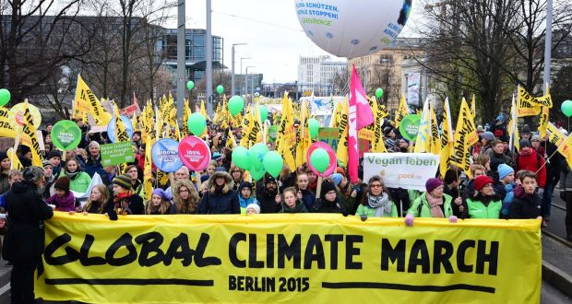
Next steps
2. Agents should have the ability to ‘know’ the social identities of others (IG/OG)
Intergroup scenarios, e.g.
helping behavior
changing membership
escalation/cascade
norm formation?

Slide 18
Next steps
3. Categorising others
Normative fit: how much they act as a group members
Comparative fit: Similarity/difference

